Slide 1
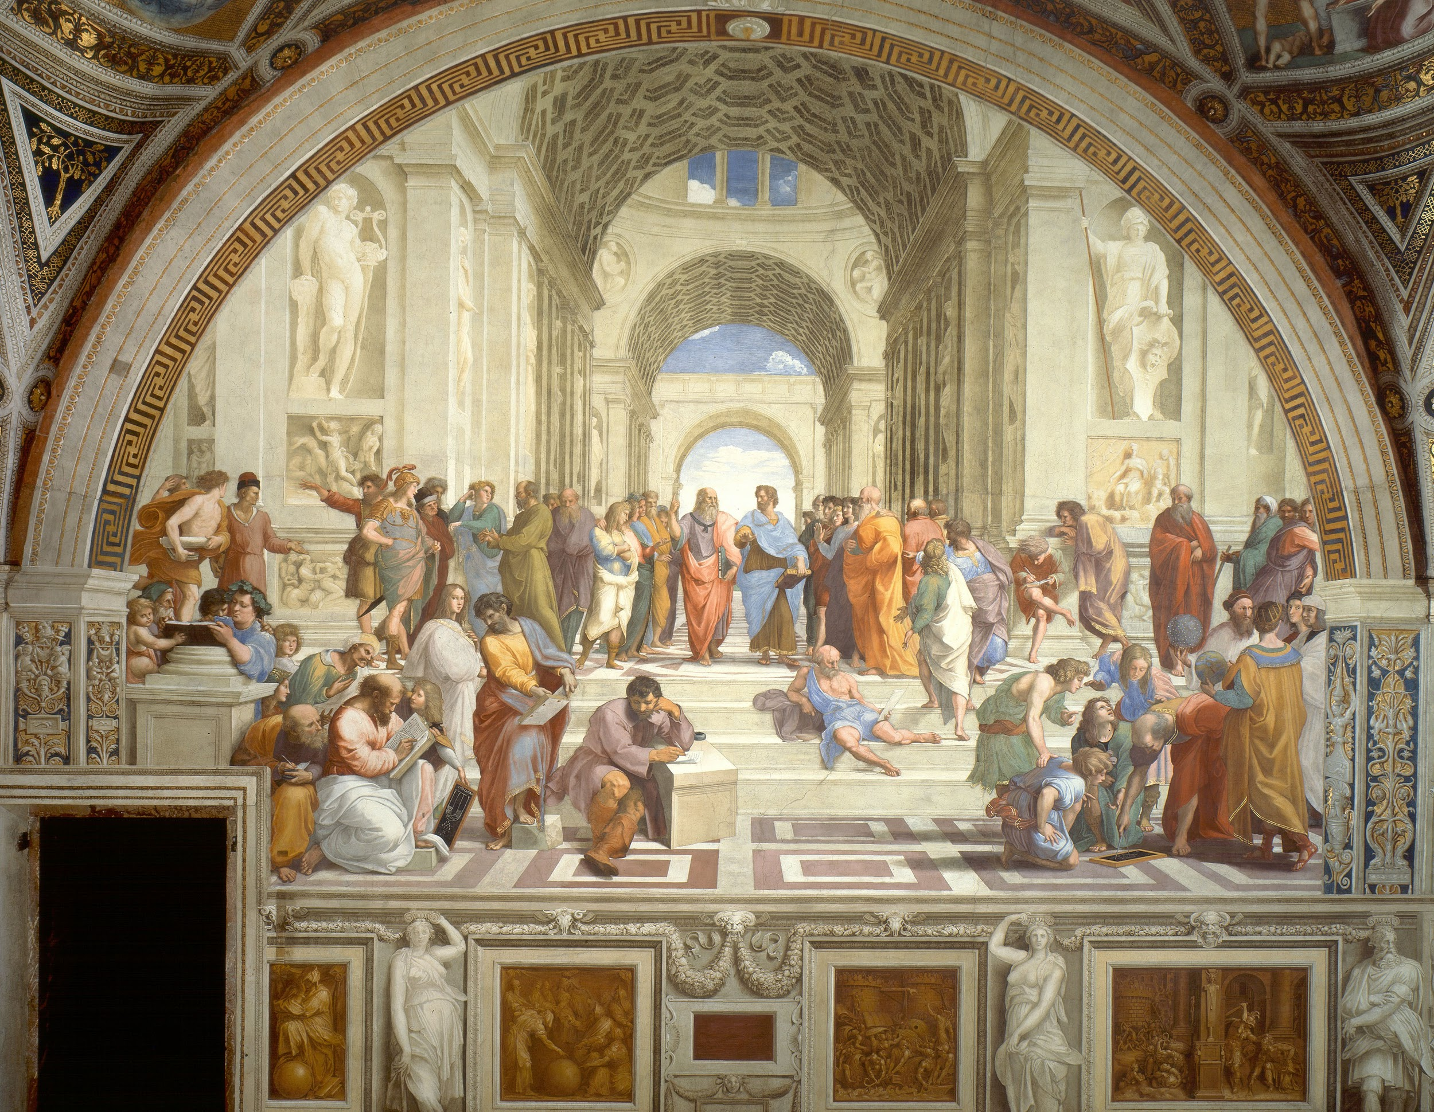
Philosophy
Classic vs Romantic
I can determine the difference between a classic or romantic point of view and apply my understanding to texts, my life, and the world.

Slide 2
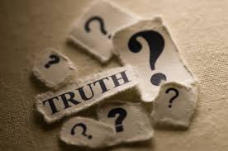
What is Philosophy?
Philosophy means “Love of Wisdom,” to study philosophy is to study:
Existence
Values
Fundamental Truths
Knowledge
Logic/Reason
Language
The mind

Slide 3
Examples of philosophical thinking:
Why do we exist?
Can truth ever be defined?
How do values become defined in a society?
What should one be willing to sacrifice in the pursuit of knowledge?
What is quality?

Slide 4
How does philosophy connect to Pirsig’s Novel?
“I want to use a dichotomy and explain it later. I want to divide human understanding into two kinds---classical understanding and romantic understanding.”

Slide 5
Classic Point of View
Emphasis on
Underlying form
Function
Facts
Driven by reason and logic
European cultures consider it masculine
Inspires order
aesthetically restrained

Slide 6
Romantic Point of View
Emphasis on:
Immediate appearance/form
Inspirational & creative
Driven by feeling & intuition
European cultures considered it feminine

Slide 7
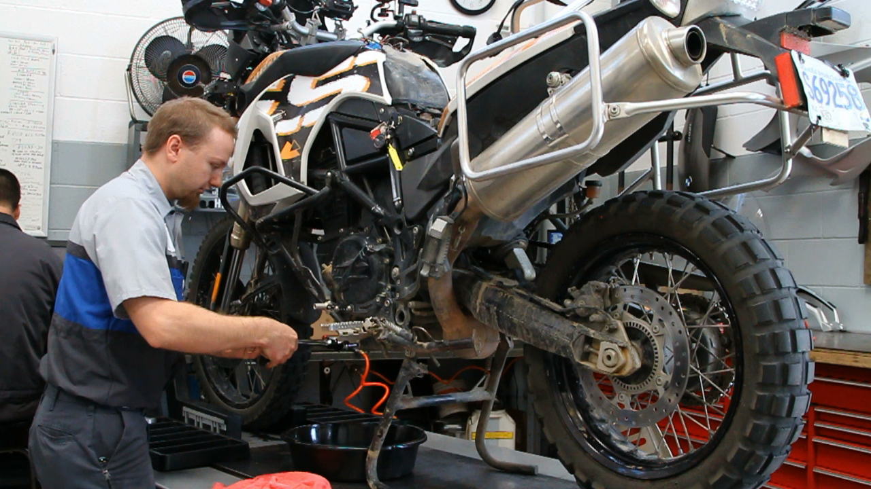
How does philosophy connect to Pirsig’s Novel?
“Although motorcycle riding is romantic, motorcycle maintenance is purely classic.”

Slide 8
According to Pirsig, what is the trouble with people and these points of view?
“Persons tend to think and feel exclusively in one mode or the other and in doing so tend to misunderstand and underestimate what the other mode is all about. But no one is willing to give up the truth as he sees it, and as far as I know, no one is willing to give up the truth as he sees it.”

Slide 9
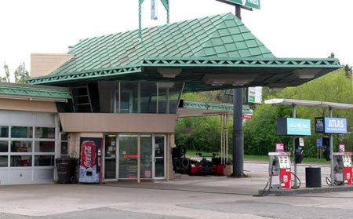
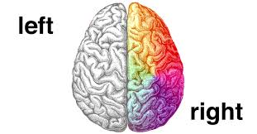
In your group create a visual that does the following:
Defines dichotomy with both words and symbol/image
Portrays a concept or object that people may view with either a “classic” view or a “romantic” view. EX:
Dichotomy: (Definition) Building
Gas Station
(Classic)
Art/Design
(Romantic)

Slide 10
Bran Ferren: To Create for the ages, let’s combine art and engineering
1.Consider Ferren’s message, how can we connect this to Pirsig’s ideas in “Zen”?
2.What is the rhetorical situation of this speech?
3.Ferren tells a personal story to explain how he got to be where he is today, what in your past has inspired you to become an engineer today?

